Slide 1
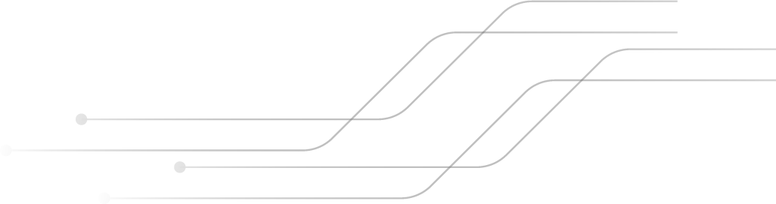
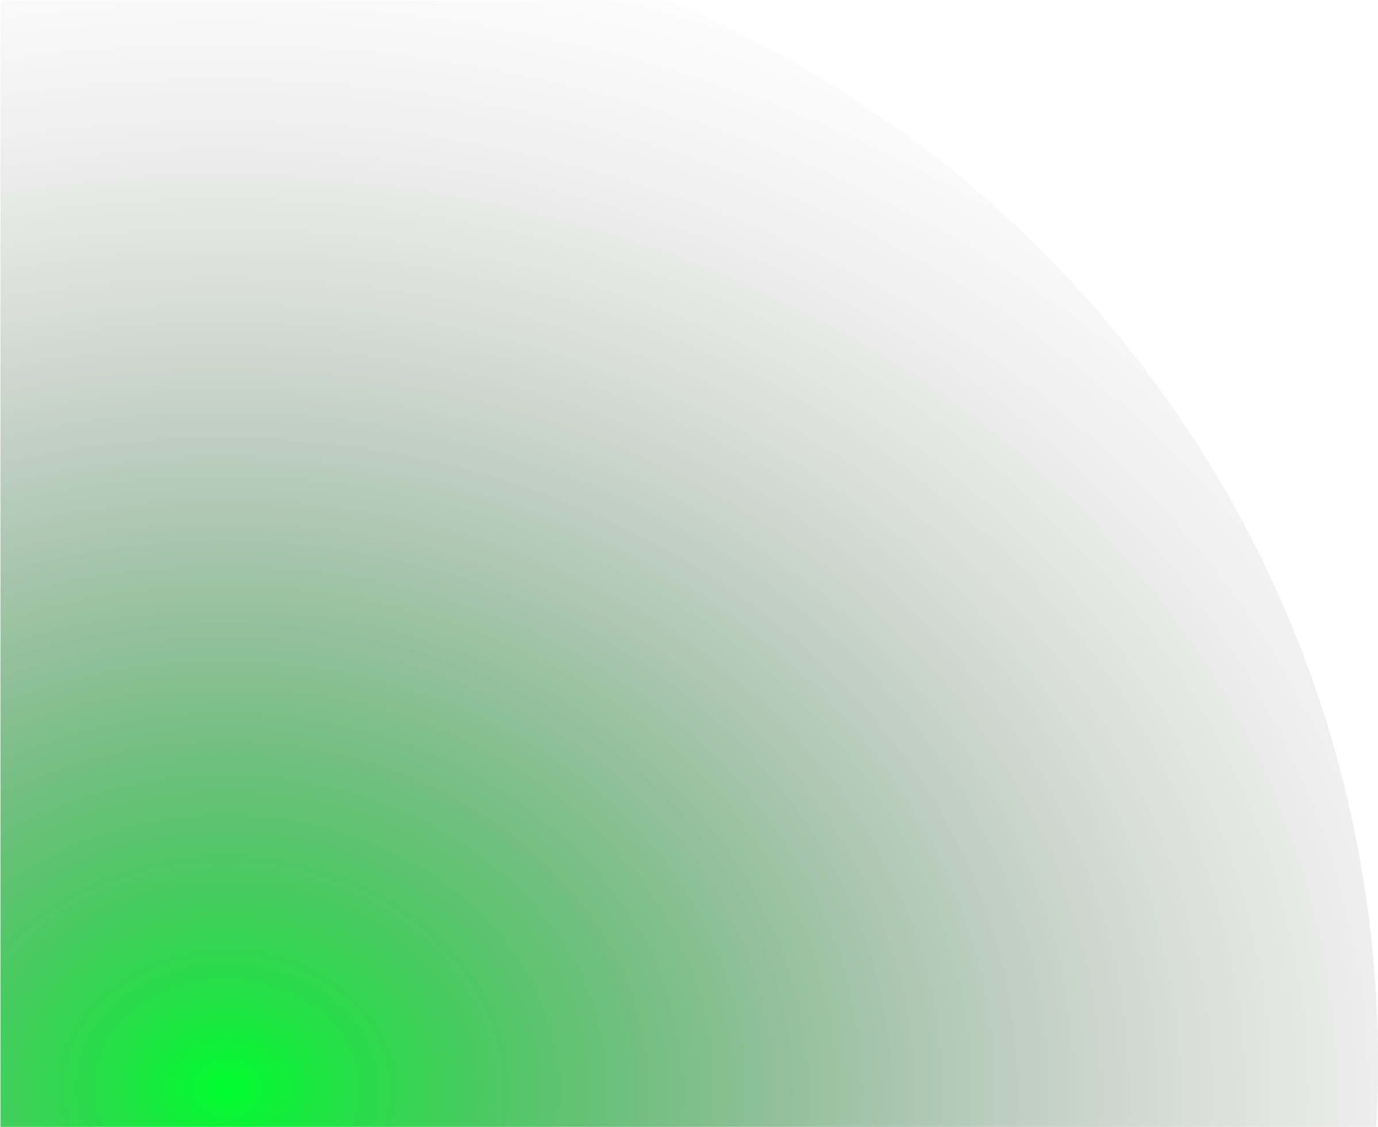
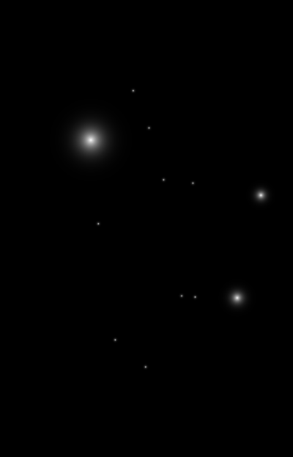
Buildings Regular Expression Interpreter
Exploring Automata Theory through Practical Implementation
By Kira Velez
Notes:
Hi welcome. My project was on Building a regular expression Interpreter.

Slide 2

If regex is a sequence of characters, why do we need an algorithm to work with them?

Slide 3

WHAT I WAS WORKING ON
Parser of Regex
Automaton Construction
Implement a parser to break down the regex into a structured form
Utilize Thompson’s construction algorithm to translate the parsed regex into an NFA.

Slide 4

ABOUT THE PROJECT
Define a regular expression syntax
Operators
Character Set
Operator Precedence
Development of the parser
Tokenize regex input
Recursive descent approach
Development of NFA
Create a data structure to represent the NFA

Slide 5
01
Why Regex Matters
Notes:
Regex provides a clear, hands-on demonstration of how abstract theoretical concepts, translate into real-world tools used in search engines, syntax parsing,

Slide 6
Email Address Validation
^[a-zA-Z0-9._%+-]+@ [a-zA-Z0-9.-]+\. [a-zA-Z]{2,}$
Kive7791@ colorado. edu
Notes:
to check if a given string is a valid email address by ensuring it contains an "@" symbol, a domain name, and a top-level domain (like ".com").

Slide 7
Regular expression syntax
Operators
Concatenation (AB): Matches A followed by B
Union(A|B): Matches either A or B
Kleene Star (A*): Matches zero or more occurrences of A.
Parentheses ((A|B)*): Group expressions for operator precedence.
Character Set
Single characters: a,b,c, etc.
Operational: Support predefined sets
Operator Precedence
Parentheses (( ))
Kleene Star (*)
Concatenation (AB)
Union (A|B)

Slide 8
Parser Development
Tokenize regex input
Convert the regex string into a sequence of tokens (e.g., a , |, *, (, )).
Recursive descent approach

Slide 9
02
Thompson’s Construction
Algorithm

Slide 10
What is Thompson’s Construction?
Method of converting regular expressions to their respective NFA diagrams
5 Simple Rules:
An Empty Expression
A symbol
Union Expression
Concatenation(Intersection) Expression
Kleene Star Expression
Notes:
Well its a method for converting regular expressions to their respective NFA diagrams. I’m not going to go into the depth of about the inner workings of why this algorithm works or its history. I’m just going to explain how it works. To begin all you need to know is that their are 5 rules to this algorithm. 1. An empty expression

Slide 11
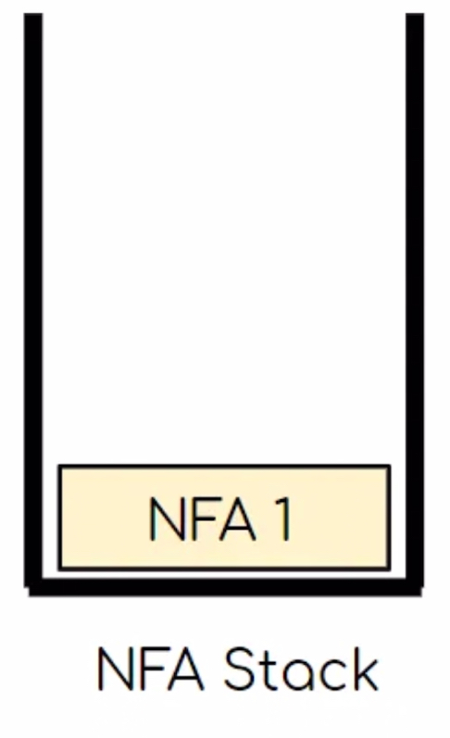
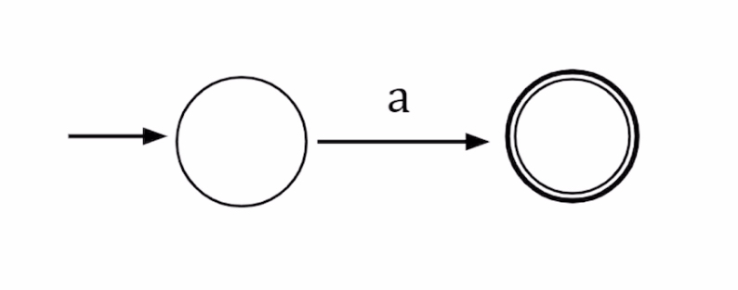
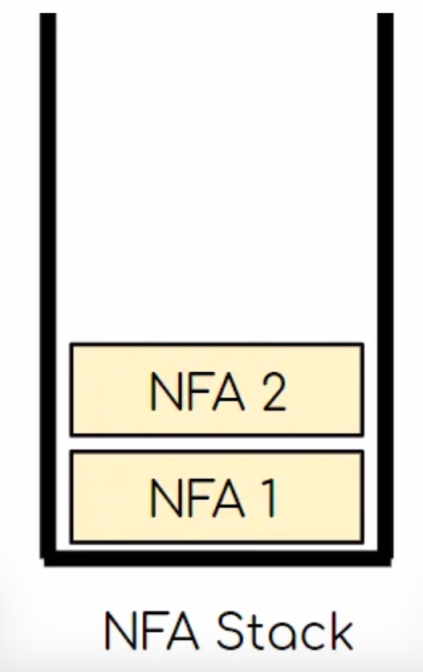
Example: a(a|b)*b
Notes:
Now that you know the rules, let’s convert a regular expression a(a|b)*b. So where do we start? At the beginning. The first symbol is an “a”, so we follow rule #2, but we come across it twice so we have to add it to the NFA stack twice.

Slide 12
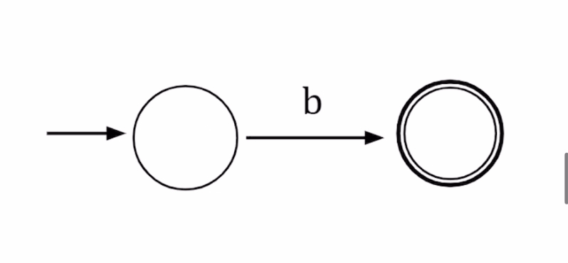
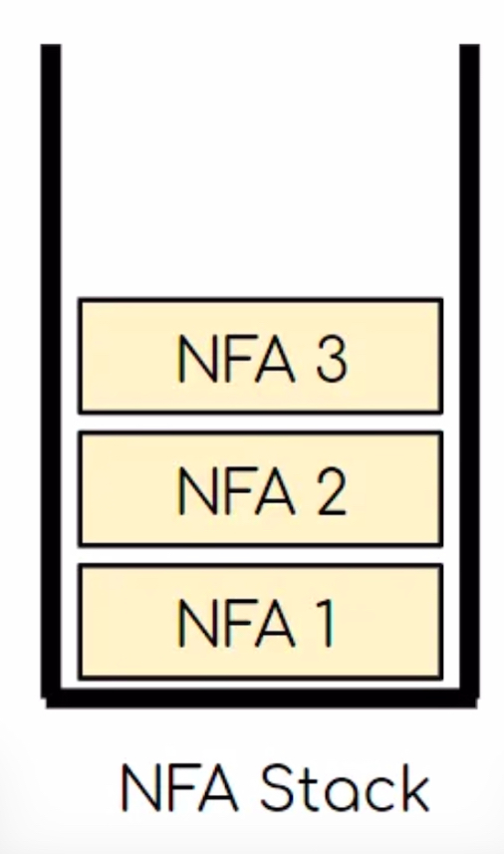
Example: a(a|b)*b
Notes:
Now that you know the rules, let’s convert a regular expression a(a|b)*b. So where do we start? At the beginning. The third symbol is an “b”, so we follow rule #2 again and add it to the NFA stack.

Slide 13
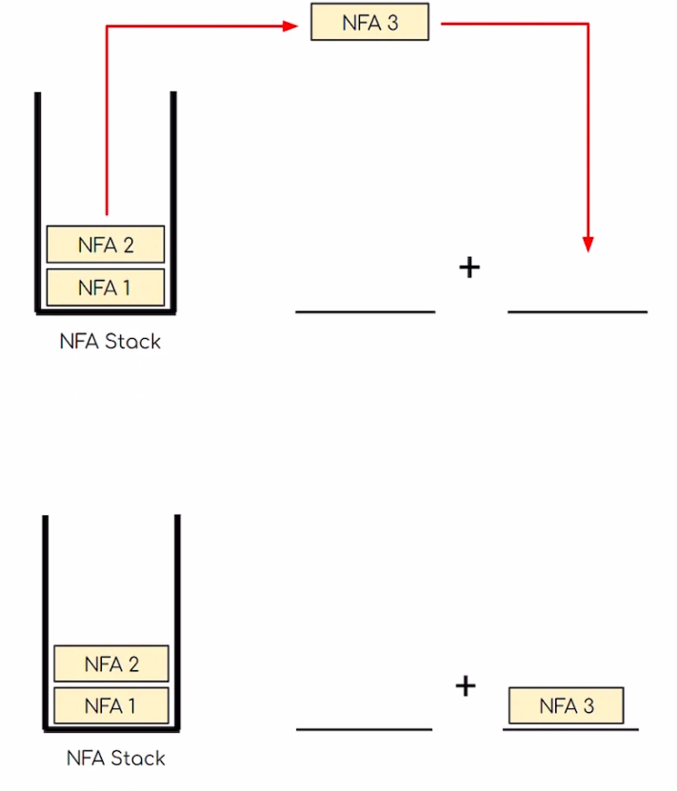
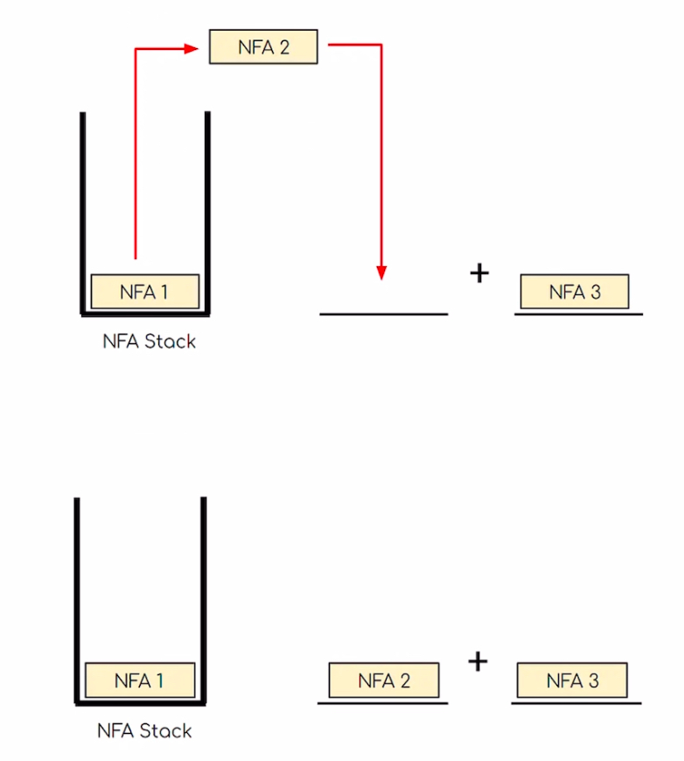
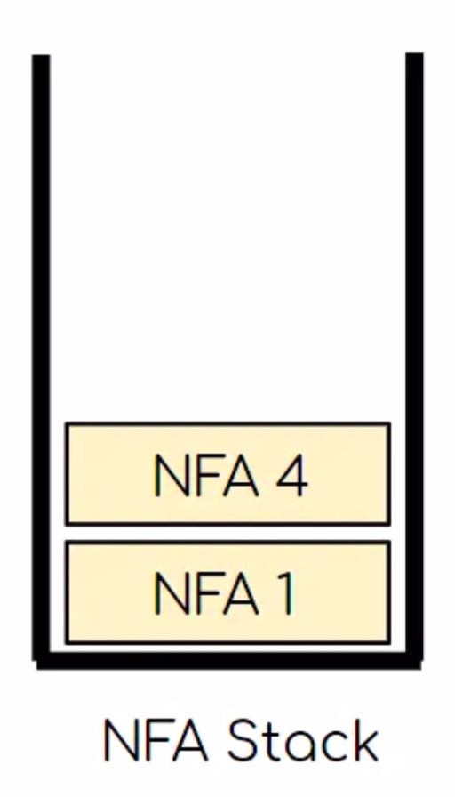
Example: a(a|b)*b
Syntax: aab|*?b?
Notes:
The | symbol is used for the Union expression, which means we need to use rule #3. So what we have to do is pop NFA3, and NFA2 to make a new NFA4.

Slide 14
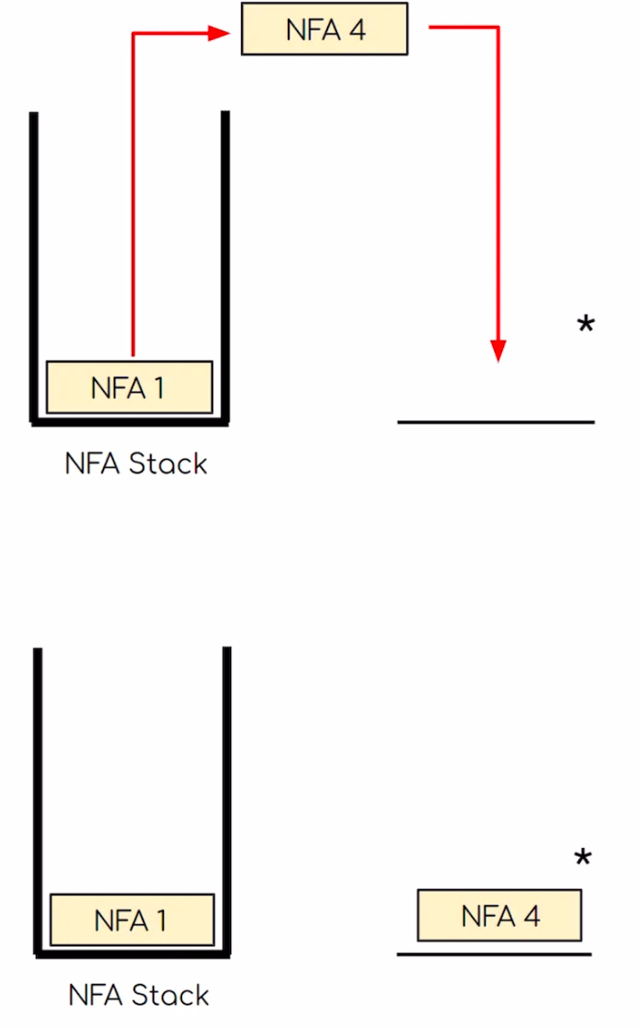
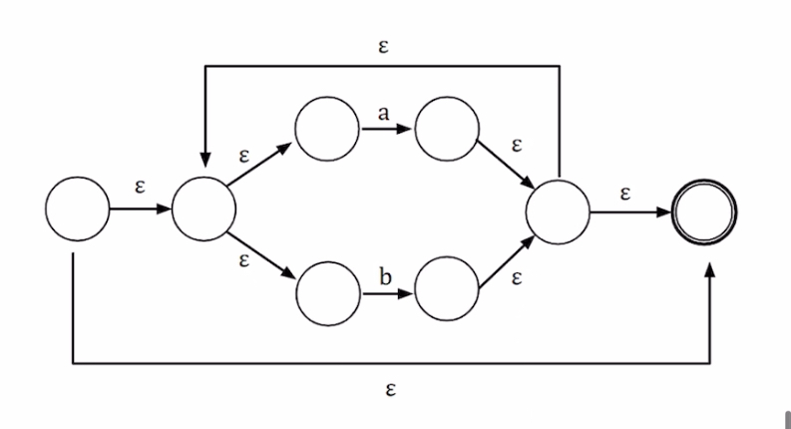
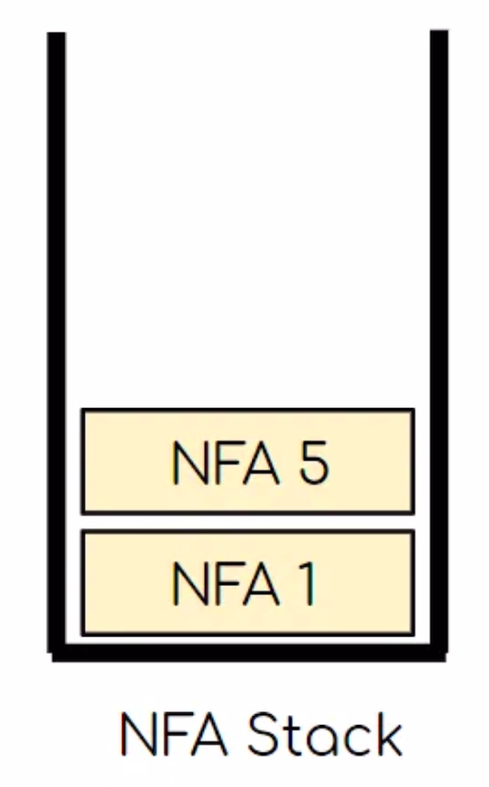
Example: a(a|b)*b
Notes:
Now we are handling the kleene star operation. So we will take NFA4 and kleene star it to create a new NFA5. By the way everytime we create a new NFA we always have to declassify the old NFA, in this case NFA4, the start state and accept state because we have new start and accepts for NFA5.

Slide 15
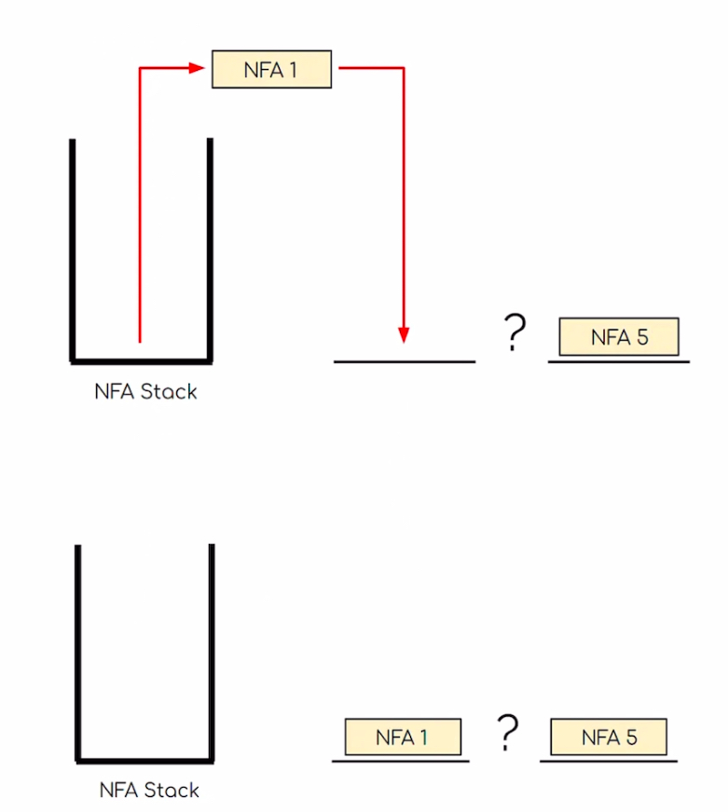
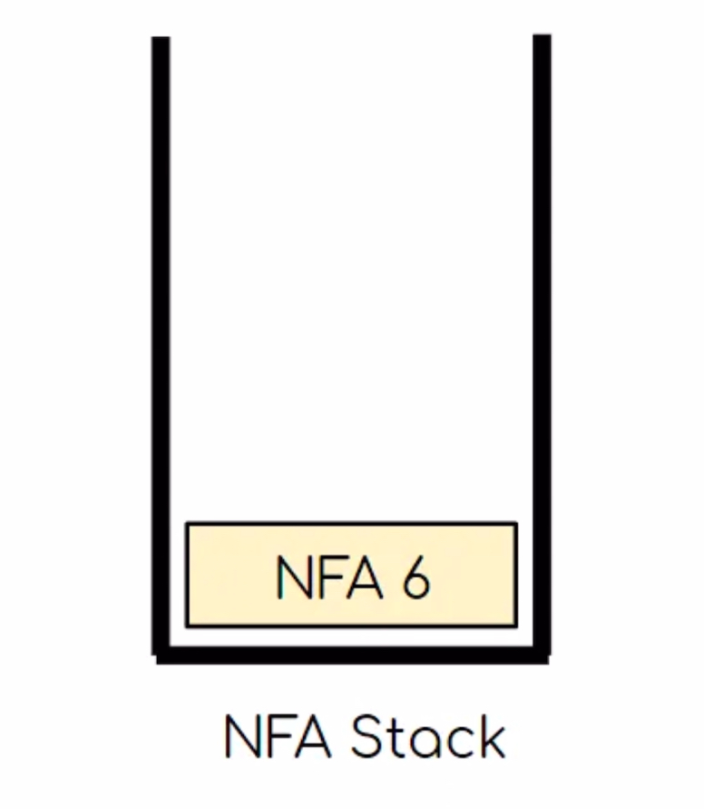
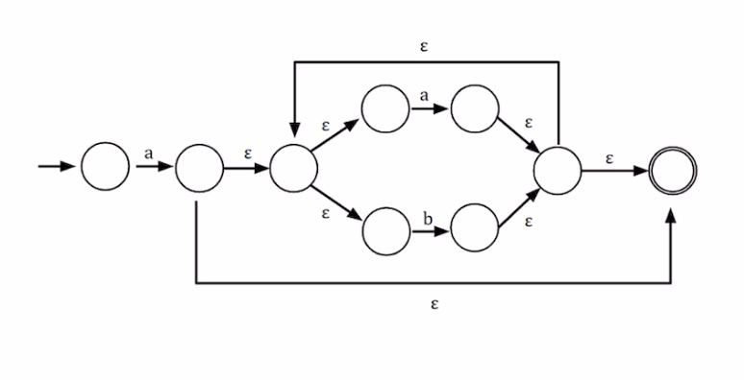
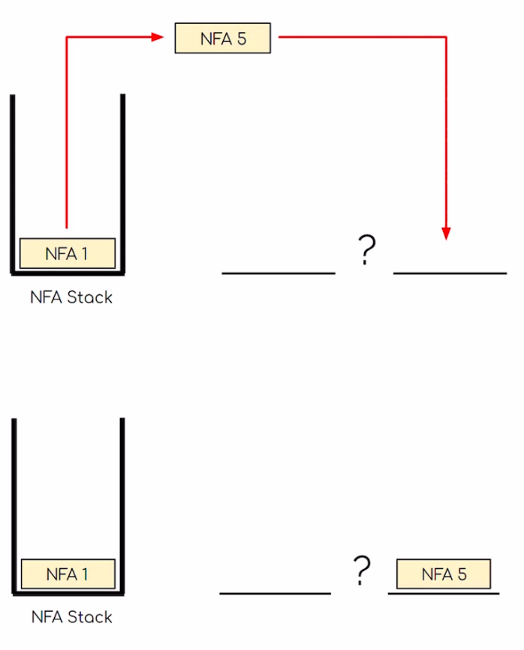
Example: a(a|b)*b
Notes:
Following rule #4, concatentation, we start by popping off the two NFA’s to combine, NFA5, NFA1 which creates NFA6.

Slide 16
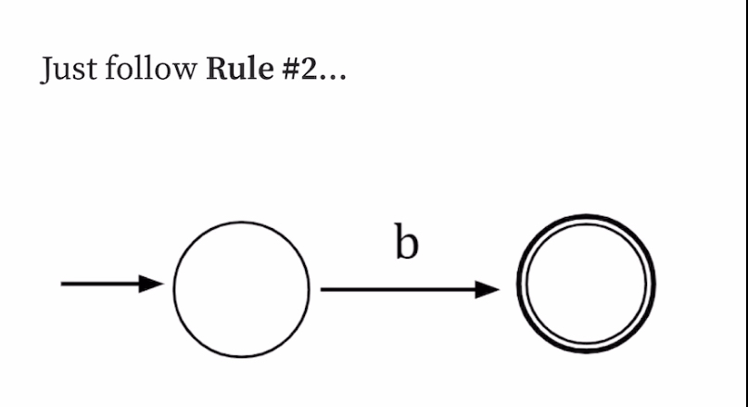
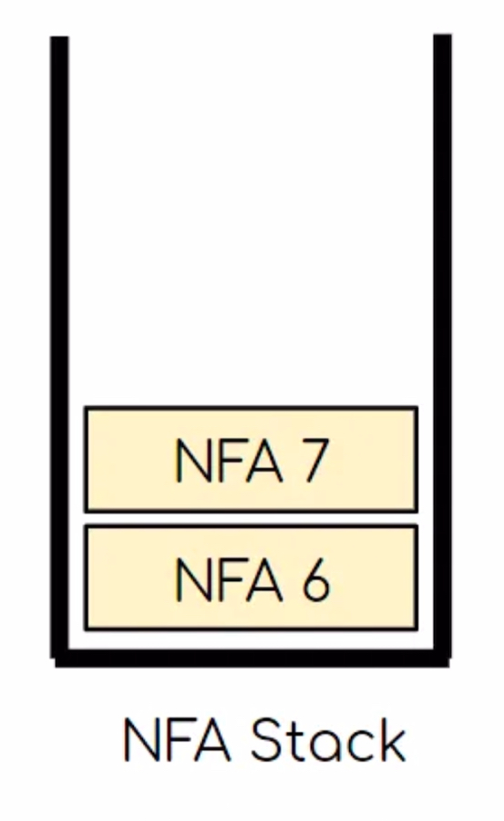
Example: a(a|b)*b
Notes:
We’ve done this before so now we are processing the input ‘b’ following rule #2.

Slide 17
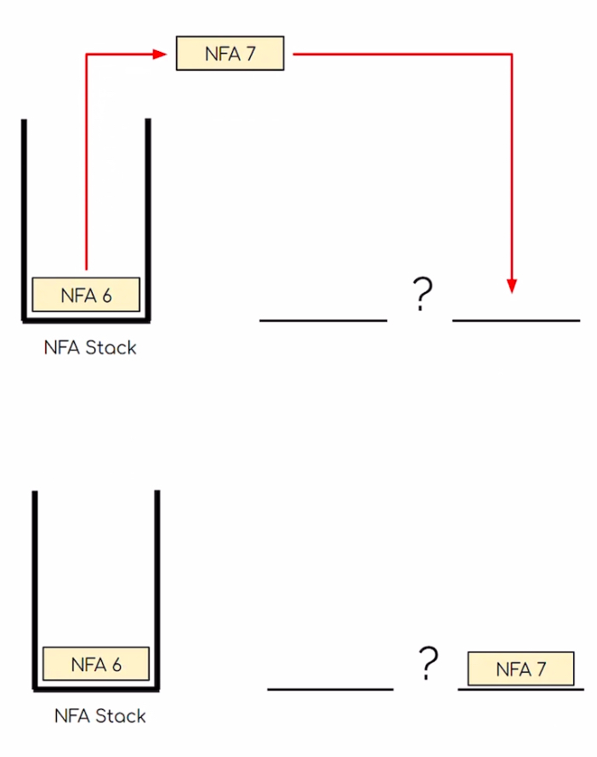
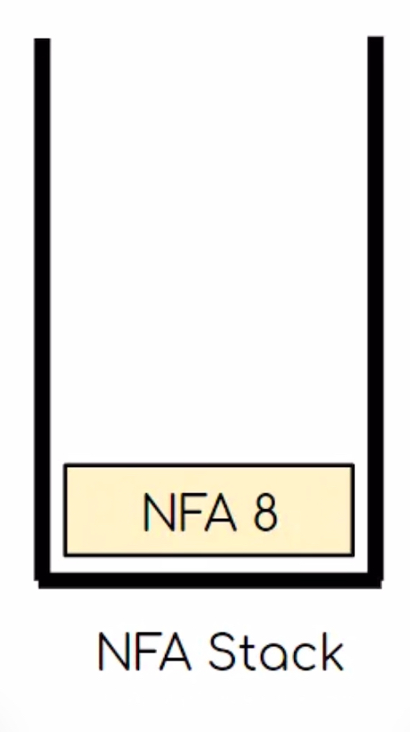
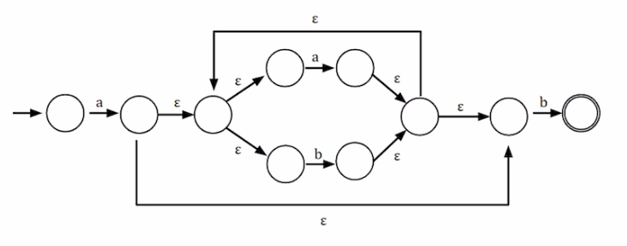
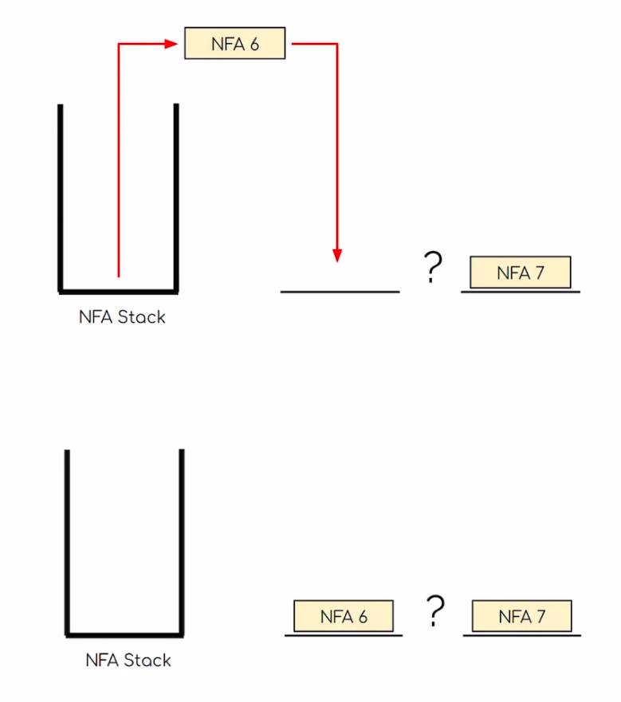
Example: a(a|b)*b
Notes:
Now time for the final rule using rule #4, concatenation. I won’t go into that much detail, do the same steps as before and you should have a final NFA. And at this point our project would relaize it doesn’t have anymore to read there for pop the only NFA left and that is our Final NFA.

Slide 18
NFA Development
Data structure for representing NFAs
States: A set of states.
Transitions: A dictionary mapping states to possible transitions (character or epsilon).
Start State: The initial state of the NFA.
Accept State: The final state(s) of the NFA.
Notes:
Now that you have some understanding of thompson’s algorithm, lets get into how I developed the NFA. First I created a data structure to represent NFAs…

Slide 19
03
Please Watch my product demo
Notes:
Now with the regular expression defined, the parser developed, and the NFA using thompson’s construction, I have a fully functioning product.

Slide 20


Slide 21
THANKS!
Notes:
Thank you for listening. Are there any question?

Slide 22
04
Potential Questions
Notes:
Potential questions

Slide 23
If regex is a sequence of characters, why do we need an algorithm to work with them?
To put it more structurally, While regex is intuitive for humans, computers need a structured way to evaluate it. Thompson's construction transforms regex into an automaton, a machine-readable format that allows systematic and efficient
pattern matching.
Notes:
Could you answer the question you started with? To put it more structurally, While regex is intuitive for humans, computers need a structured way to evaluate it. Thompson's construction transforms regex into an automaton, a machine-readable format that allows syst atic and efficient
pattern matching.

Slide 24
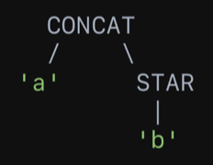
What does the AST and Parser look like?
Input: ab*
Tokens: [ a,b,*]
Term: CONCAT(Literal('a'), STAR(Literal('b')))

Slide 25
What are tokens?
Tokens are the basic units of a regex, like a, 1, *, or (. The tokenizer converts the input string into a list of tokens, making it easier to process the regex systematically. Tokenization ensures the parser can focus on structure rather than character-by-character processing.

Slide 26
Why did you choose a recursive descent approach for parsing?
I chose the recursive descent approach because it is straightforward to implement and well-suited for the simple grammar of regular expressions. It allows me to directly map the regex grammar rules into functions that build the AST.

Slide 27
How did you test Everything?
I used a variety of test cases, including:
• Simple regex patterns (a, a*, a |b).
• Complex patterns ((a|b)*, ab|c).
• Edge cases ("'，a**，（a'）.
I implemented these tests using Python's 'unittest' framework, ensuring the parser worked as expected and handled errors gracefully.

